Slide 1

Take Care of Your Financial Health:
Sign up for a Health Advantage Flexible Spending Account (FSA) from Optum
<date>
<presenter name, title>

Slide 2
Instructions to Presenter
Customize the cover slide to your audience.
Go through the presentation and fill in the variables as it pertains to the customer you’re presenting to. These are marked in red, except for slide 13 where the variables are in the orange header.
Delete any information or product offerings that do not apply to your presentation.
Delete the “Instructions to Presenter” slide after you finalize your presentation.
Delete slide 10 if you offer the carryover option.
Delete slide 11 if you do not offer the carryover option.
Delete slide 12 if your plan does not allow grace period for health care or dependent care accounts.

Slide 3

Optum Financial Services
Optum administers the flexible spending account offered by <company>.
When you enroll, you will receive a welcome letter with information on how
to submit claims and contact us.
Our commitment is to provide you with
the best customer service and help you understand your plan.

Slide 4



The benefits of a Health Advantage FSA
Estimate your health care expenses
Save on taxes
Pay for
health care

Slide 5

Ways to save
Pre-tax contributions
Dependent care flexible
spending account
Your share of your employer’s medical and dental contributions are deducted from your pay pre-tax
Allows you to save on daycare and/or some adult care expenses

Slide 6
How you save money
Pre-tax dollars
Tax savings
Average savings
  The amounts that you contribute to your Health Advantage FSA are deducted from your paycheck on a pre-tax basis.
  This means you don’t
  pay federal and often state income taxes on these amounts.
  You can save these taxes:
  Federal 15% to 35%
  State 4% to 7%
  FICA 7.65%
  The average employee can save
  20% or more
  on dollars contributed to a flexible spending account!

Slide 7
Examples of tax savings
In this example of the tax savings, the employee earns an annual compensation of $35,000. The employee has elected to contribute $1,000 toward a Health Advantage FSA and $5,000 toward a dependent care FSA. The contributions for the plan year will total $6,000.
 | With FSA Plan | Without FSA Plan
Annual earnings Health/dependent care expenses reimbursed by plan | $35,000 ‒$6,000 | $35,000 ‒$0
Taxable compensation Estimated federal income taxes, Social Security and Medicare (FICA) tax at 7.65% | $29,000 ‒$8,700 | $35,000 ‒$10,500
After-tax compensation Health/dependent care expenses paid after-tax | $20,300 ‒$0 | $24,500 ‒$6,000
Spendable income after taxes and expenses | $20,300 | $18,500
Total estimated
savings:
$1,800 or $150/mo.

Slide 8

Who is eligible and when can I enroll?
Good news! You don’t have to be enrolled in your employer’s medical plan to participate.
If you are benefit-eligible, you can enroll in a Health Advantage FSA.
If your spouse has a plan, you might be able
to use both plans for medical expenses.
Each year, you will need to enroll before the plan year begins. This is usually completed during your employer’s open-enrollment period.

Slide 9

Making election changes
After a new plan year begins, you generally cannot change your benefit election. However,
if there is a family status change, such as one
of those listed below, you may be able to change
your election.
Status changes include:
Marriage or divorce
Birth or adoption
Death of spouse or child
Change in your or your spouse’s
employment status, including termination
Unpaid leave of absence

Slide 10
Use it or lose it
Your flexible spending accounts operate on a “use it or lose it” basis — unused funds in the account will be forfeited. Even if you have a small forfeiture, you may still come out ahead on your taxes.
The following shows the effect of a forfeiture based on a 30% tax bracket (federal, FICA and state taxes, where applicable)
Using pre-tax deductions with a forfeiture
Contribution amount taken before taxes | $500
Expenses amount | ($400)
Forfeiture | $100
As you can see,
even with the forfeiture
of $100, the employee still saved $50: the difference between the amount paid in taxes
and the forfeiture.
Same dollar amount taken as taxable compensation
Amount taken as taxable compensation | $500
Taxes | ($150)
Total spendable income | $350

Slide 11
Carryover Feature
Your Health Advantage FSA (general and limited purpose) can carryover up to <$0.00> of unused dollars to the next plan year (instead of forfeiting unused amounts).
Any balance which exceeds the allowable carryover after the run out period ends will still be forfeited.
Your dependent care account is still a “use-it-or-lose-it” plan.
You may be able to carry over into the subsequent plan year a balance even if no salary reduction contribution is made that year.
The carryover amount will not count against your health FSA annual allowable election.
During the run-out period, potential carryover amounts may be used either for prior year or current year reimbursements.
No cash-out of unused amounts or a transfer of unused amounts to other taxable or nontaxable benefits is permitted

Slide 12

Grace Period
Your plan has a grace period provision for your <healthcare account> and <dependent care account> which will allow you to continue to incur services for <variable> two months and fifteen days beyond the end of the plan year and get reimbursed from the prior years balance.
You will have additional time after the grace period has ended to submit your claims for reimbursement.

Slide 13

Health care flexible spending account
Under your plan, the maximum and minimum you can elect for the health care FSA is:
Maximum : $<insert amount ‒ variable number>
Minimum : $<insert amount ‒ variable number>
When calculating your election amount, remember
to include expenses for yourself, your spouse and/or your tax dependents
Expenses submitted to the Health Advantage FSA cannot be reimbursed by an additional source, such as from your or your spouse’s employer-sponsored health and/or dental plan
These expenses also cannot be deducted on your or your spouse’s tax return

Slide 14





Let’s look at an example
The Gonzales family contributes $1,900 to a Health Advantage FSA. Here’s what they save in taxes:
$323
Federal tax at 25%
$145
FICA at 7.65%
$76
State tax at 4%
Gonzales Family
$544
Total tax savings
Hypothetical example is for illustration purposes only.
Costs, circumstances and tax rates may vary.

Slide 15
Save money on taxes
2
1
3
SOCIAL SECURITY & MEDICARE TAX-FREE
STATE TAX-FREE (in most cases)
FEDERAL TAX-FREE

Slide 16


FSAs help you manage out-of-pocket costs
FSA
Estimate how much you want to contribute
Pay for eligible medical expenses
Save on taxes

Slide 17

Use your Health Advantage FSA to pay for eligible expenses
Pay for these services and more
Doctor’s office visit copays
Chiropractic services
Prescriptions
Dental care (including extractions and braces)
Vision care (including contacts, prescription sunglasses and LASIK)
Dependent care
Keep your receipts!
$

Slide 18

Dependent care flexible spending account
Requirements:
Care must be for one or more qualifying individuals
A qualified individual must be a dependent claimed on your taxes
Expenses must be for you and spouse to work, look for work or go to school full-time
Minimum election is <$0.00> and the maximum
annual election is $5,000 per household per tax year

Slide 19

Dependent care flexible spending account
Additional requirements:
Must be for children under age 13
Can also be used for adult child or spouse physically incapable of caring for him/herself
Amounts paid for “educational care” must be
for pre-kindergarten or younger ages
Provider of care must report the income
by providing employee name, address and
Tax ID or Social Security number
Employee reports on tax form whether
FSA or tax credit is used

Slide 20

Dependent care flexible spending account
Dependent care FSA versus the dependent
care tax credit
  Tax credit allows federal tax savings only
  Dependent care FSA allows more immediate reimbursement
Depending on your combined income,
you might benefit more from the dependent care FSA. It is recommended you check with your tax preparer
The same expenses can only be claimed once

Slide 21

Estimate the amount you should contribute
Understand the participant contribution limits.
In <insert year>, yearly health care FSA contributions will be limited to $<insert amount>, and yearly dependent care FSA contributions will be limited to $<insert amount>.

Slide 22

Start by estimating costs of planned services
Use the estimated total as a starting point for deciding on how much to set aside in your FSA for the next year.
Co- insurance
Co-pays
$
+
$
+
$
Orthodontia
Prescription drugs
Other expenses
(e.g., vision, etc.)
Review your plan to learn what expenses are eligible.
Estimated total

Slide 23

Over-the-counter materials and supplies
Eligible over-the-counter (OTC) materials
and supplies
Insulin and diabetic supplies
Elastic bandages and wraps
Contact lens supplies and solutions
OTC drugs and medicines only eligible when prescribed
Allergy and sinus
Pain relief
Cough, cold and flu
OTC drugs and medicines not eligible
Dietary supplements (e.g., vitamins) that are merely beneficial to the person’s health
Toiletries or similar preparations (such as toothpaste, shaving lotion, shaving cream, etc.)
Cosmetics (such as face creams, deodorants, hand lotions, etc., or any similar preparation used for ordinary cosmetic purposes)

Slide 24
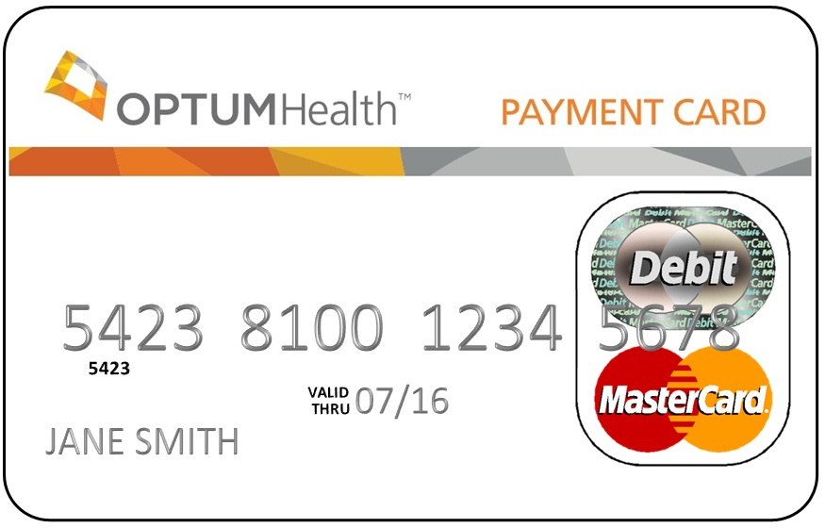
Paying for qualified expenses
Paying for expenses is convenient
Participants receive two payment cards: one for themselves and one to share with a spouse or dependent
Activate the card right away
Use it to pay for eligible expenses
Review your plan to learn which
expenses are eligible

Slide 25

Added convenience: Optum MasterCard® payment card
Your Optum payment card can be used at eligible merchants and medical providers where you incur FSA-eligible expenses.
You can use the payment card instead of your own cash or credit card to pay for any eligible expenses.
Keep your receipts! The IRS requires it. Optum might also require additional substantiation to determine eligibility.
If you go to a merchant that uses the Inventory Information Approval System
(IIAS), you usually will not be asked to submit documentation for those items you purchased using your payment card; however, you should always save your receipts.
The card will be mailed to your home in
a plain white envelope from Benefit
Payment System.

Slide 26
Getting your money back
Payments are made to you, the participant. You will be responsible for paying the provider.
Prepare your claim
Submit your claim
Submit a claim online or complete a Claim for Reimbursement form
Include copies of your valid receipt or documentation such as itemized receipts or Explanations of Benefits (EOB) Documentation that shows: date expense was incurred, amount of expense, description of the service or item you bought. Please note: cancelled checks are not acceptable.
Review your documentation and your reimbursement form
for completeness
Be sure to sign and date your form
Submit your claim and documentation online
OR
Mail or fax your Claim for Reimbursement form with documentation to Optum

Slide 27
How to submit claims
There are four methods of submission available
for your claim form and documentation:
Online
Visit our website: optumhealthfinancial.com
Login to your account. File your claim from the “I Want To” section in the upper left corner of the Home Page
Substantiation can also be uploaded
Mobile App
Fax
Mail
Regardless of your submission method, you will want to make sure you submit legible documentation. If we are unable to read items because of the quality of the copy, the claim will be denied pending resubmission of legible documentation.
Supporting documentation must clearly identify:
  Name of provider or clinic providing the eligible service
  Description of service
  Date expense was incurred
  Total expense amount
  Signature and date (of claim submission)
Canceled checks and credit card statements are not valid receipts.

Slide 28

Receiving your reimbursement
You decide if you want your reimbursement direct-deposited into your bank account or if you want to receive a check in the mail.
An EOB statement will be mailed to your home with the check or deposit confirmation.
Your plan allows you to submit claims for the previous plan year through <include run-out date>. All expenses need to be incurred by <insert last date of the plan year or applicable grace period>.

Slide 29

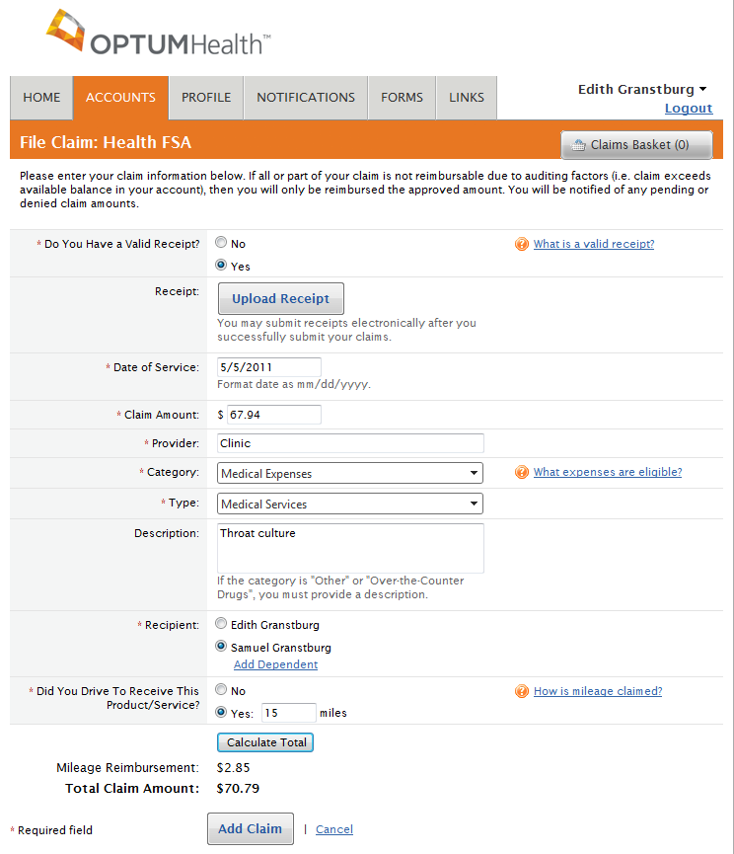
Manage your account online
At optumhealthfinancial.com,
you can:
View account balances and
upcoming payments
Receive notices of claim denials
Sign up to use our mobile app
Sign up for direct deposit
Change your reimbursement method
Manage your personal information
Download service forms

Slide 30

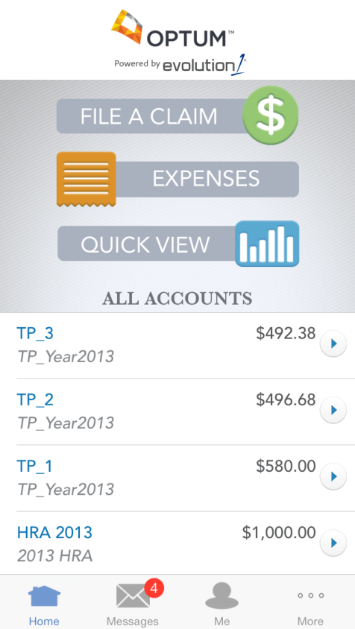
Your account is at your fingertips
Health Advantage mobile app by Optum
Submit claims for reimbursement
Access account details including balances, transaction history, and claim status information
Take a picture of your receipt and submit for a new or existing claim
Receive text alerts
Report a lost or stolen card
Download the mobile app directly from iTunes and Google Play stores or login to optumhealthfinancial.com

Slide 31
Limited-purpose FSA plans
If you are enrolled in a health savings account (HSA) you might be eligible to enroll in your employer’s limited-purpose flexible spending account (FSA) to pay for dental and vision care.
  It works just like a regular FSA, the amount is deducted from your paycheck over the current year, before taxes and your annual election is available on the first day of the plan year.
  Your plan allows you to elect up to <$0.00> each plan year.
  Funds are available for eligible dental and vision expenses only
  Funds are available at the
  start of the plan year
  You can change your
  contribution amount only
  if you have a qualifying event
  You may lose unused funds
  in your Health Advantage FSA at the end of
  the plan year. Refer to your plan documents for details.

Slide 32
Health Advantage FSA reminders
Health care plan: Minimum: $<insert> | Maximum: $<insert>
Dependent care: Minimum: $0 | Maximum: $5,000
Plan year: <insert date> through <insert date>
Grace period: <variable> from the end of the plan year to incur expenses in your <Health FSA or dependent care FSA>
Carryover: <funds may be carried over to the following plan year in your health FSA>
Previous claims: Your plan allows you to submit claims for the previous plan year through <insert run-out date>; all expenses need to be incurred by <insert last date of the plan year>
Election: Irrevocable for the plan year unless you have an eligible status change event
The date of service: Date the service is received not necessarily when it’s paid for (exception for over-the-counter purchases)

Slide 33
THANK YOU FOR WATCHING THIS OPTUM PRESENTATION.
To learn more, talk to your employer or visit optumhealthfinancial.com.
Flexible Spending Accounts are administered by OptumHealth Financial Services, Inc. and are subject to restrictions. This communication is not intended as legal or tax advice.
Please contact a competent legal or tax professional for personal advice tax treatment and restrictions. Federal and state regulations are subject to change.
Hypothetical example is for illustrative purposes only. All events, persons and results described herein are entirely fictitious and amounts will vary depending on your unique circumstances. Any resemblance to real events or persons, living or dead, is purely coincidental. Current rates are variable and may change at any time.
©2014 Optum, Inc. All rights reserved.
41969-092014

